Slide 1
Case Study 1
Beers: ABV, IBU, and Distribution by State

Slide 2
GITHUB LINK
https://github.com/jules-stacy/DS6306_Case_Study_01.git

Slide 3
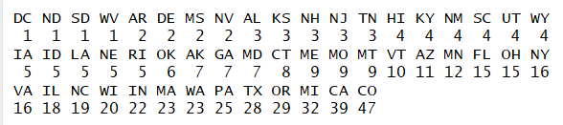
Breweries in Each State
Top states for breweries are: CO, CA, MI, and OR
States with the least breweries are: DC, ND, SD, WV

Slide 4
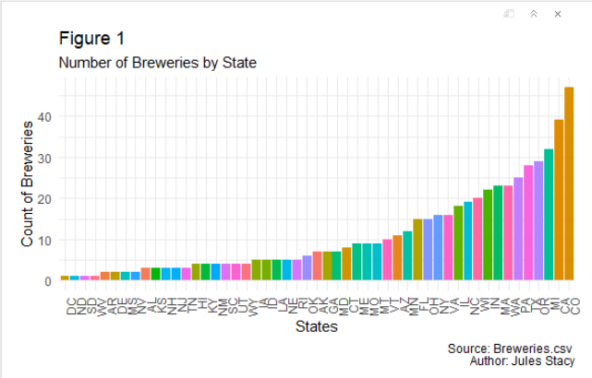

Slide 5
Missing Values
ABV analyses can include missing IBU values (and vice versa)
For ABV and IBU combination analyses: no NA values

Slide 6
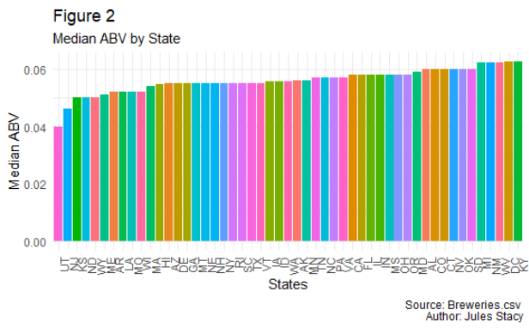
Median ABV by State

Slide 7
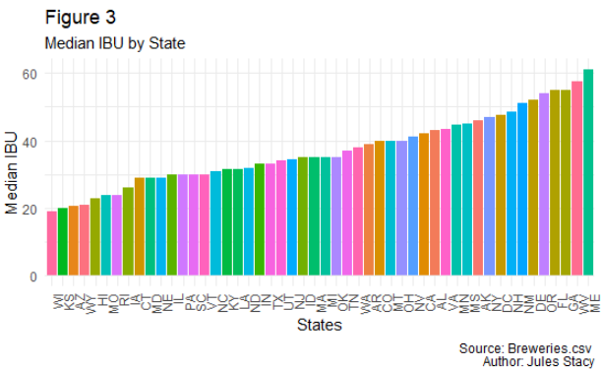
Median IBU by State

Slide 8
Highest ABV and IBU
Colorado has the beer with the highest ABV at 0.128
Oregon has the most bitter beer with an IBU of 138

Slide 9
ABV Descriptive Statistics
Mean = 0.05987305
Median = 0.056
Standard Deviation = 0.01352549
Variance = 0.0001829388
Quartile Ranges:
Min. 1st Qu. 3rd Qu. Max.
0.00100 0.05000 0.06800 0.12800
95% of beers will fall between 0.03282208 and 0.08692402 ABV

Slide 10
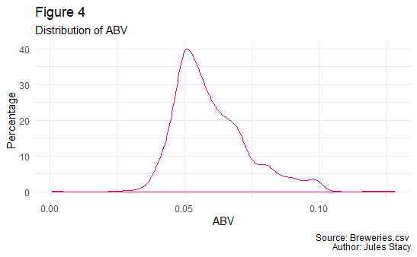
ABV Distribution

Slide 11
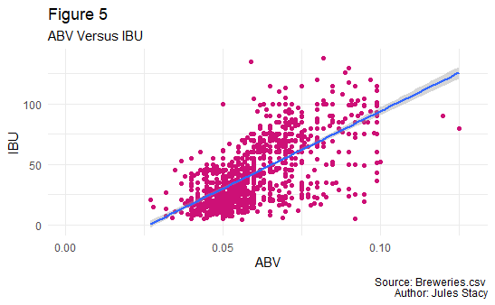
ABV vs. IBU

Slide 12
ABV vs. IBU
Linear relationship:
y= 0.0003506x + 0.0450713
Correlation: 0.6690977
67% of the data is explained by the fitted line
ABV and IBU are moderately related.

Slide 13
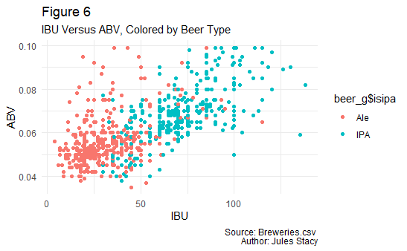
IBU vs. ABV, IPA vs. Ale

Slide 14
K-NN Testing
Nearest-neighbor
Determines beer type based on the types of the nearest known points
Train-Test: separates a training set and uses it as a litmus test on a test set
Leave-One-Out: uses the entire set in one chunk, going point-by-point

Slide 15
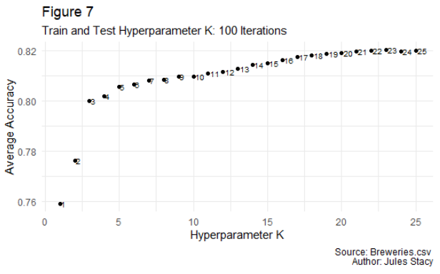
Train and Test
Optimal number of comparison points: 9

Slide 16
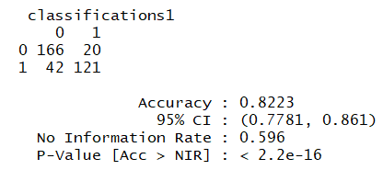
Train and Test: Results
The computer was able to determine whether a beer was an IPA or an Ale based on IBU and ABV 82.23% of the time
Results were statistically significant

Slide 17
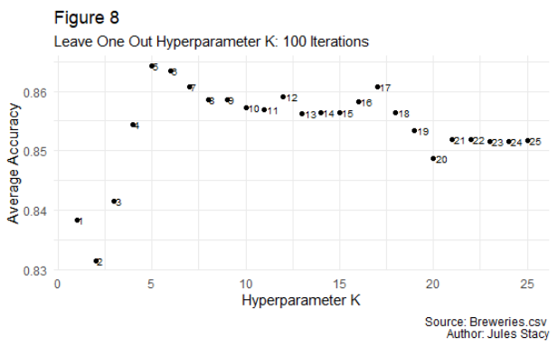
Leave One Out
Optimal number of comparison points: 5

Slide 18
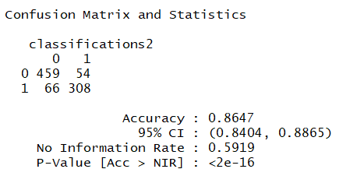
Leave One Out: Results
The computer was able to determine whether a beer was an IPA or an Ale based on IBU and ABV 86.47% of the time
Results were statistically significant

Slide 19
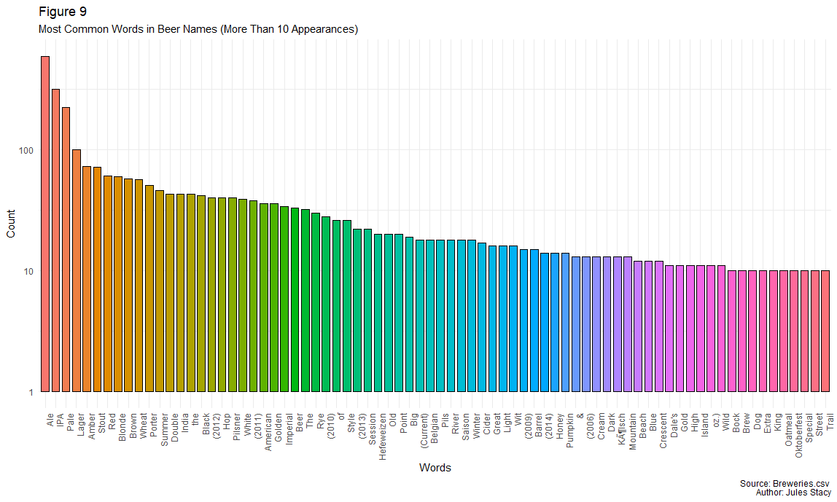
Most Common Words in Names

Slide 20
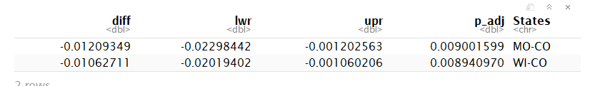
ABV Differences by State
Colorado has stronger beers than Missouri and Wisconsin (statistically significant)
Worth investigating if there is a market for Colorado beer in these states

Slide 21
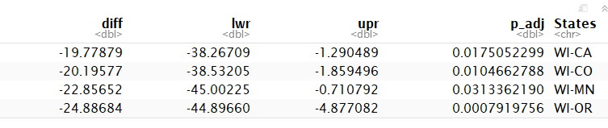
IBU Differences by State
Wisconsin has less bitter beer than California, Colorado, Minnesota, or Oregon
IPA’s may not do well in Wisconsin

Slide 22
Case Study 1
Beers: ABV, IBU, and Distribution by State

Slide 23
Most Common Words in Names
The most common naming convention for beers is to name it by the type of beer
“Ale” is top choice
“of”
complex name, probably not attributed to type
“Barrel” and “Old”
Aged beers
Years
Good year for hops or an experimental year
“Wild”
Source of beer ingredients

